Slide 1

GIT make a HIT

Slide 2
GIT : Version Control System
Version Control?
GIT make a HIT

Slide 3

Version Control?
최종보고서_완성_마지막_final
최종보고서_완성_마지막
최종보고서_완성
최종보고서

Slide 4
Complex

Slide 5
git add
git commit
git add -a
git push
Workspace
Staging
Local
repository
Remote
repository
git diff
git fetch
git diff head
git reset <commit>
git clone/pull

Slide 6

Use cloud first!
One Drive
Google Drive
Dropbox

Slide 7
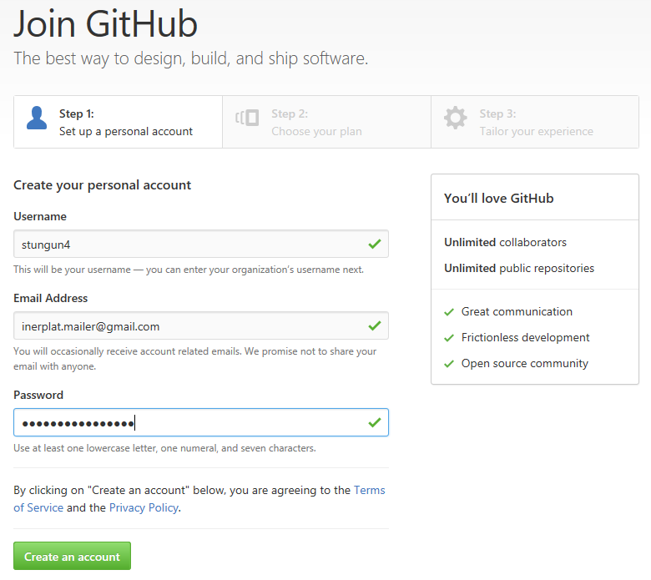

Slide 8
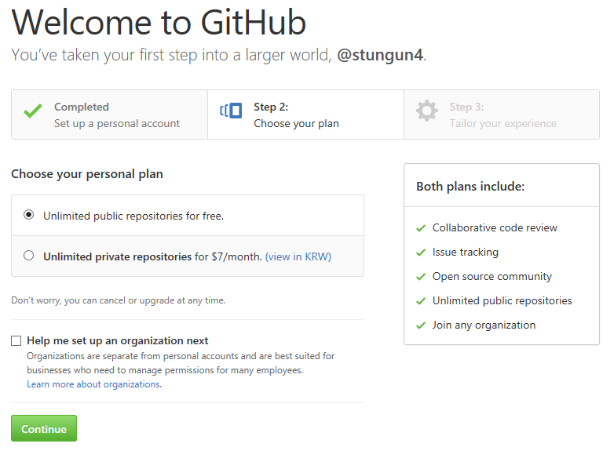

Slide 9
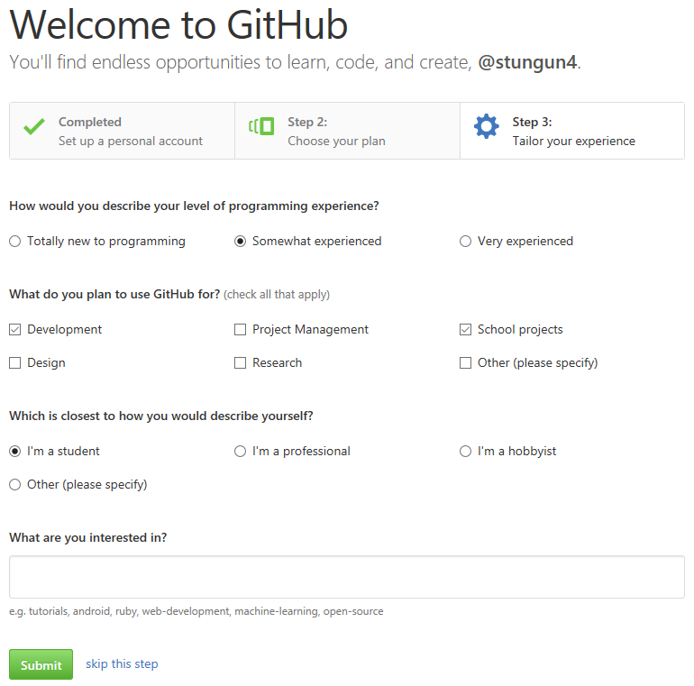

Slide 10
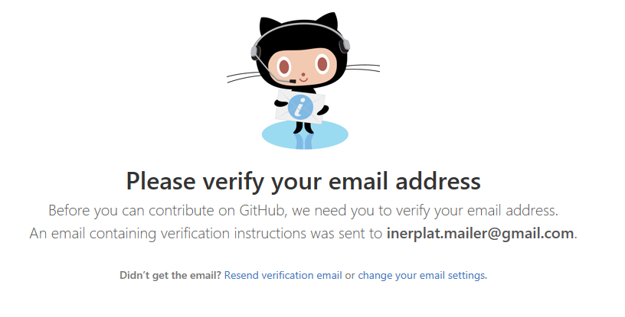

Slide 11
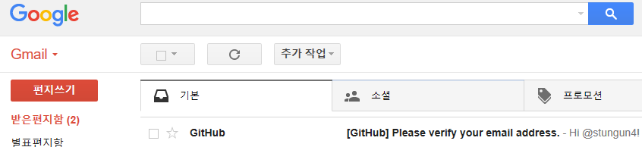

Slide 12
Let’s start GIT
Git Bash
X
stungun4@user MINGW64
$ git init
$ git add 1.txt
$ git commit

Slide 13
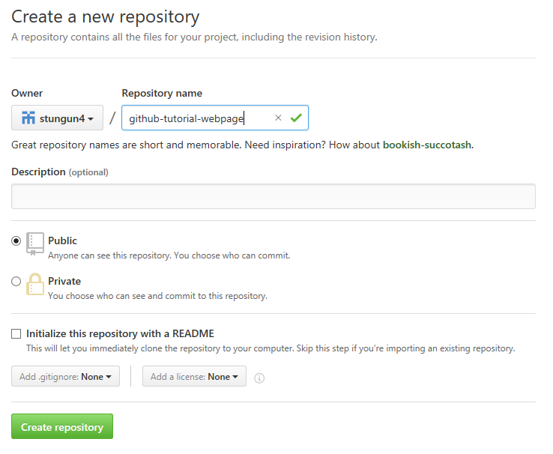

Slide 14
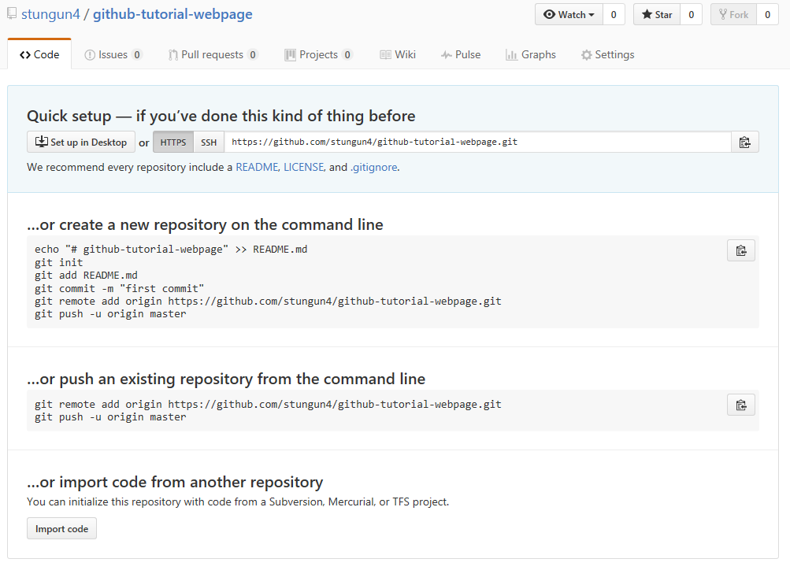

Slide 15
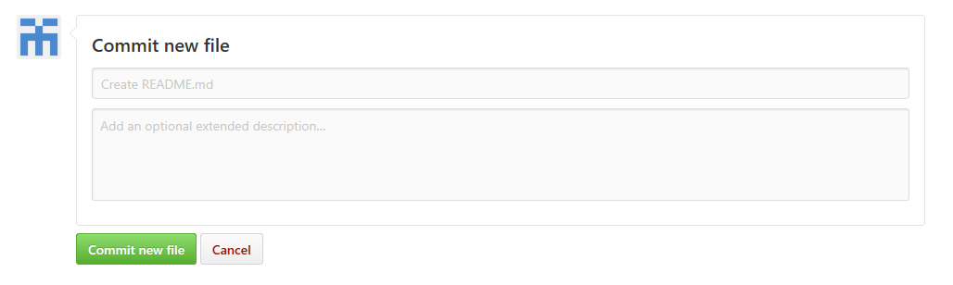

Slide 16
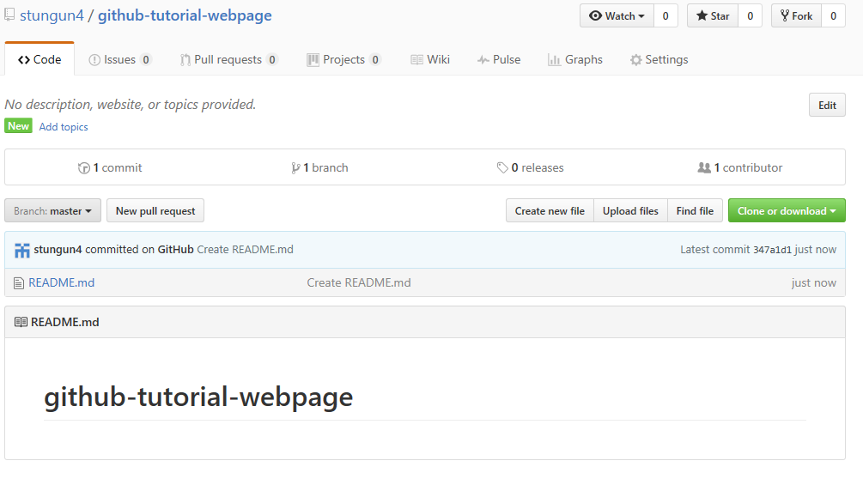

Slide 17
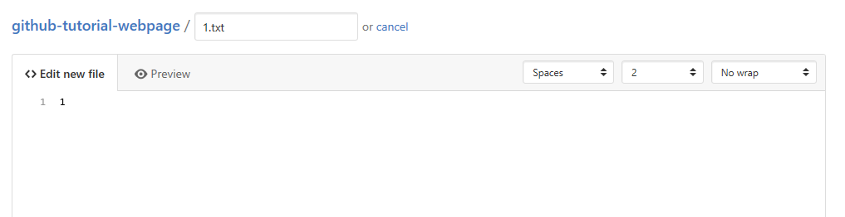

Slide 18
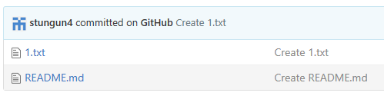

Slide 19
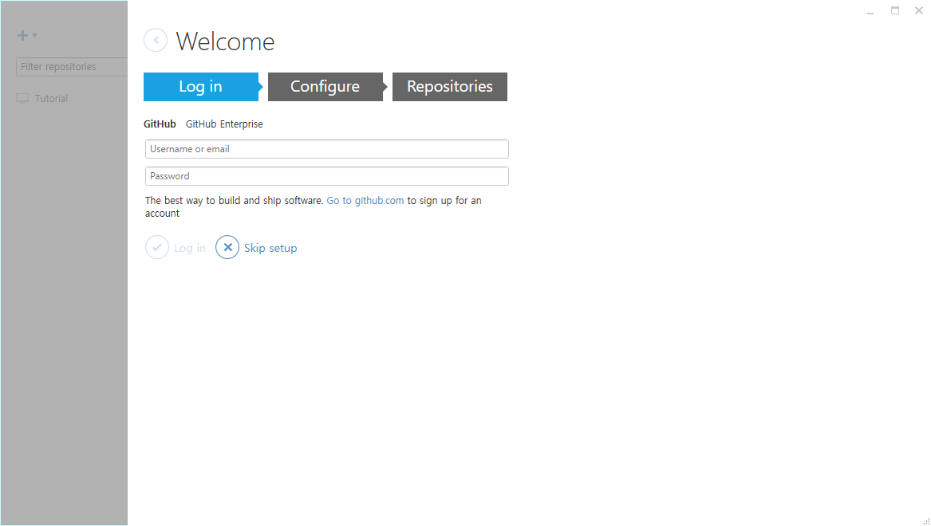

Slide 20
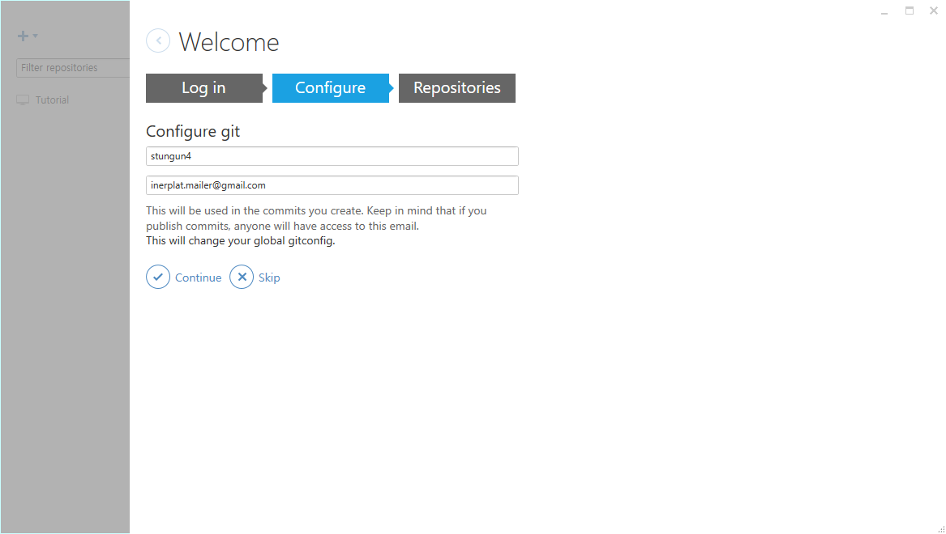

Slide 21
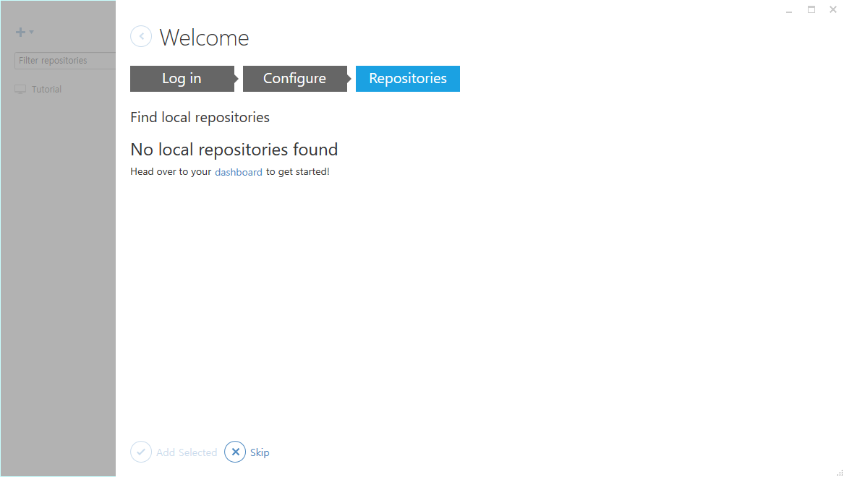

Slide 22
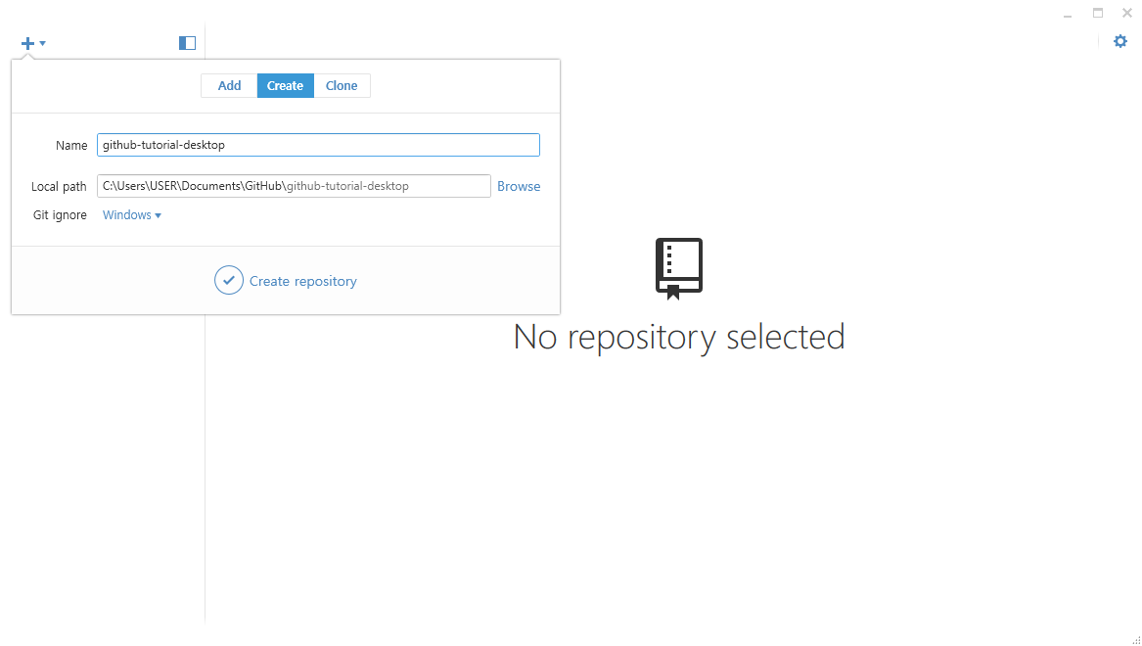

Slide 23
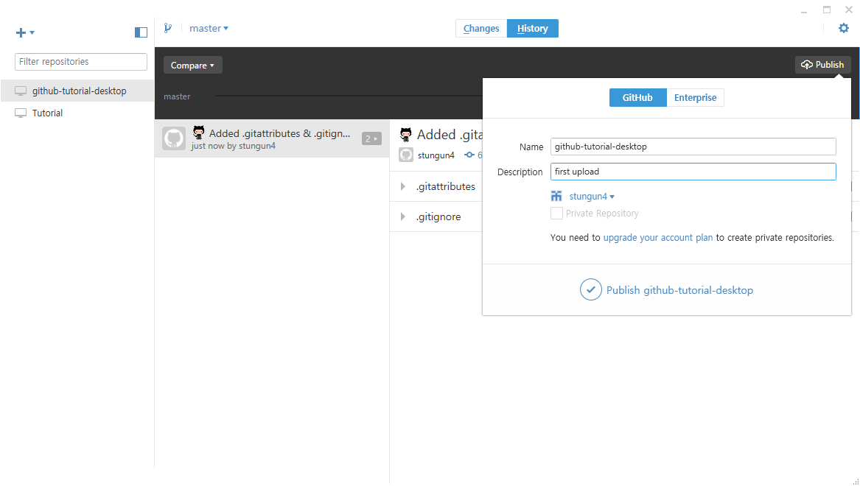

Slide 24
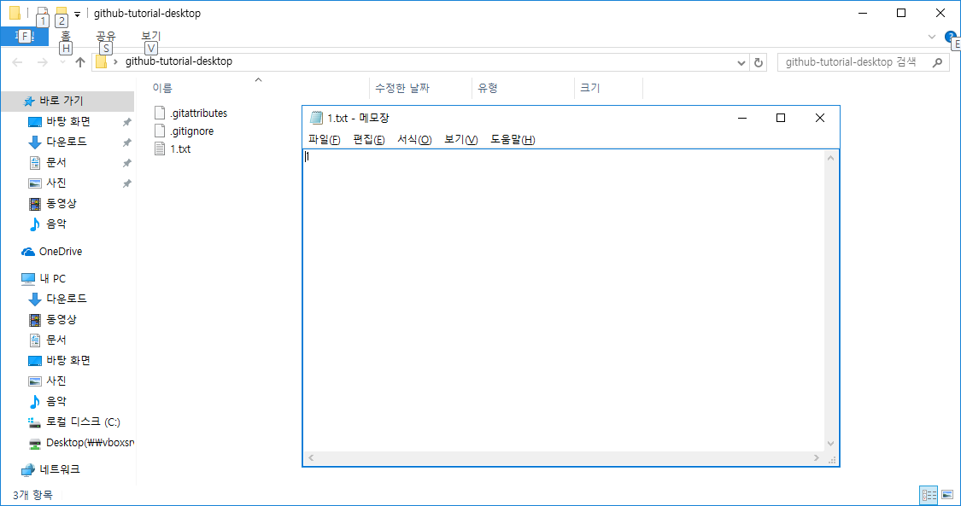

Slide 25
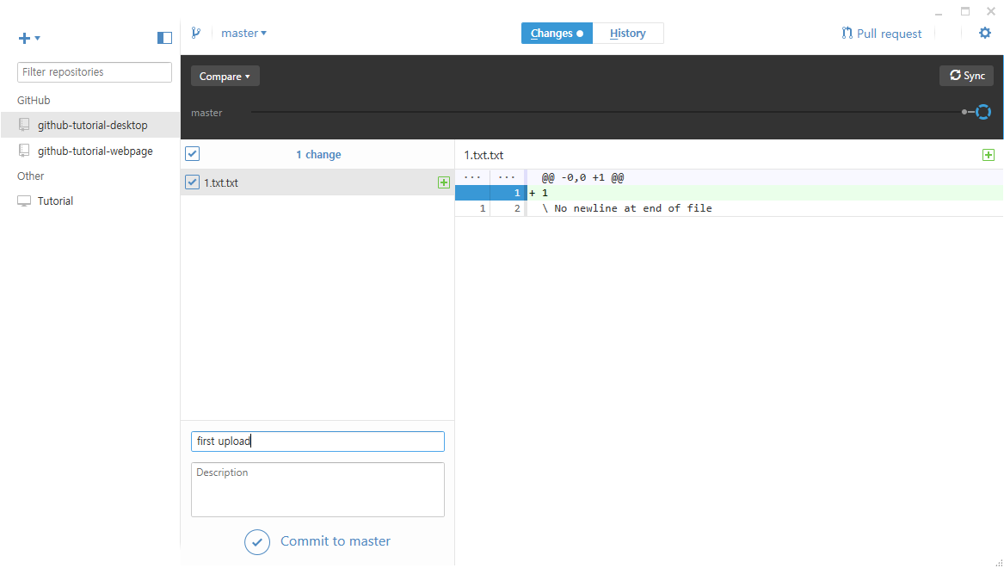

Slide 26
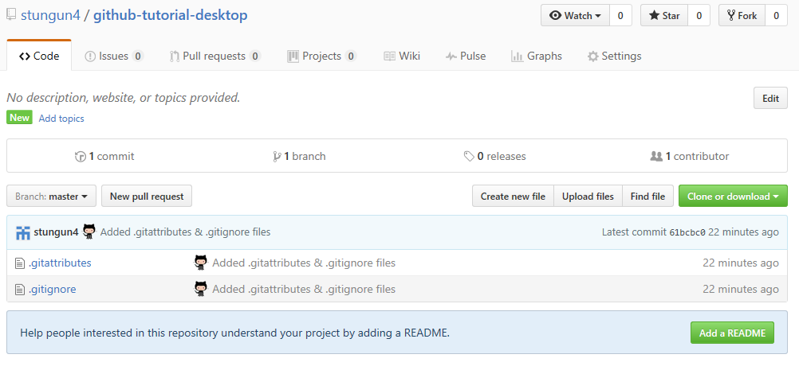

Slide 27
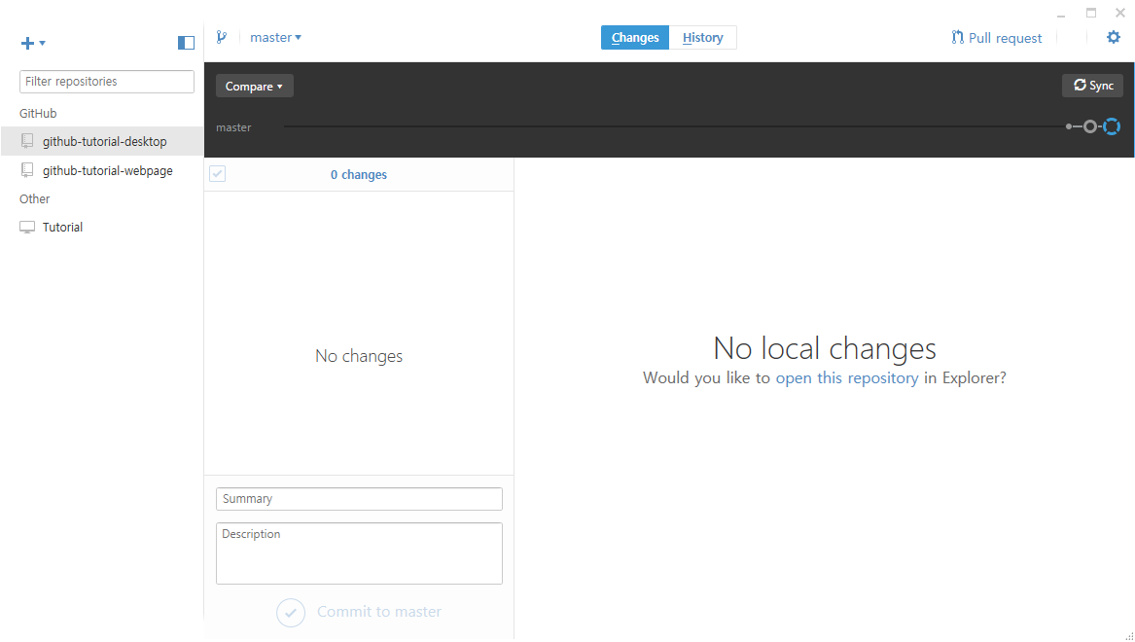

Slide 28
Clone Local Repository
Git Bash
X
stungun4@user MINGW64
$ git clone stungun4@github.com/github-tutorial-desktop.git

Slide 29
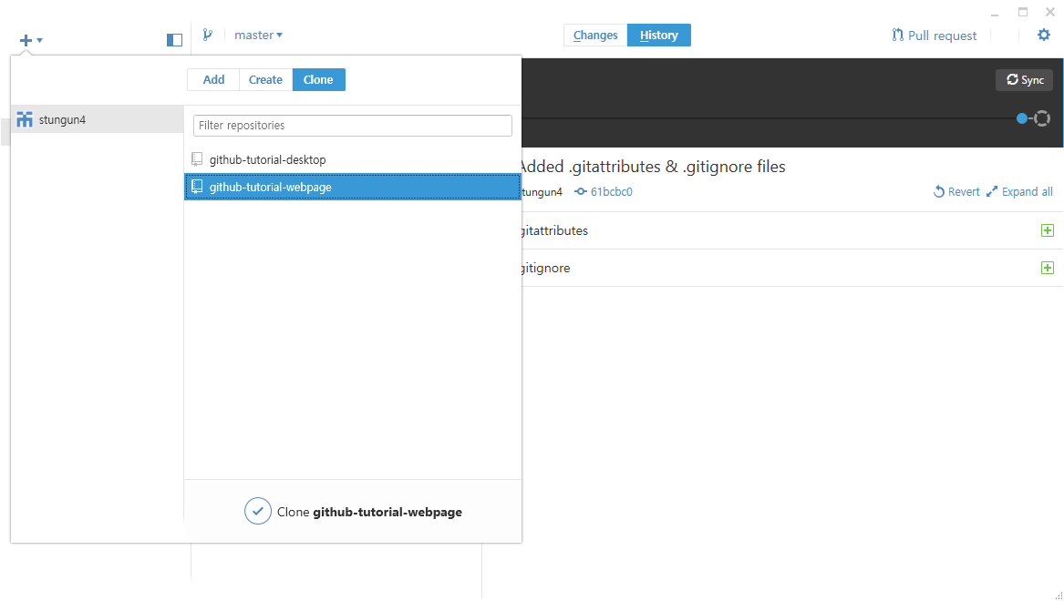

Slide 30
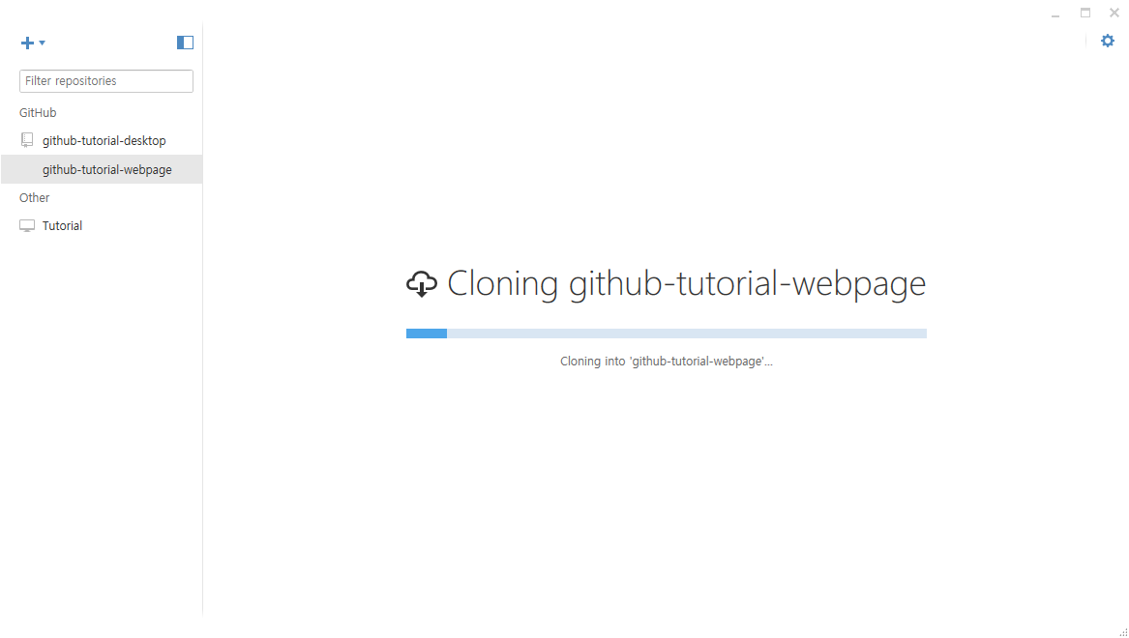

Slide 31
Branch,
masterpiece of GIT
Git Bash
X
stungun4@user MINGW64
$ git branch bugFix

